Slide 1

The 5th International Conference on Applied Convergence Engineering (ICACE 2024)
August 12-13th, 2024
Dynamic Learning Policies and Predictive System for Enhanced Machine Failure Prediction in Stochastic Environments
Presenter: Thang Le Quoc,
Logistics Automation Laboratory
Department of Logistics, Korea Maritime & Ocean University

Slide 2
Contents
01
Introduction
02
The high-order neural network
03
Methodology
04
Stimulation
05
Result
06
Conclusion

Slide 3
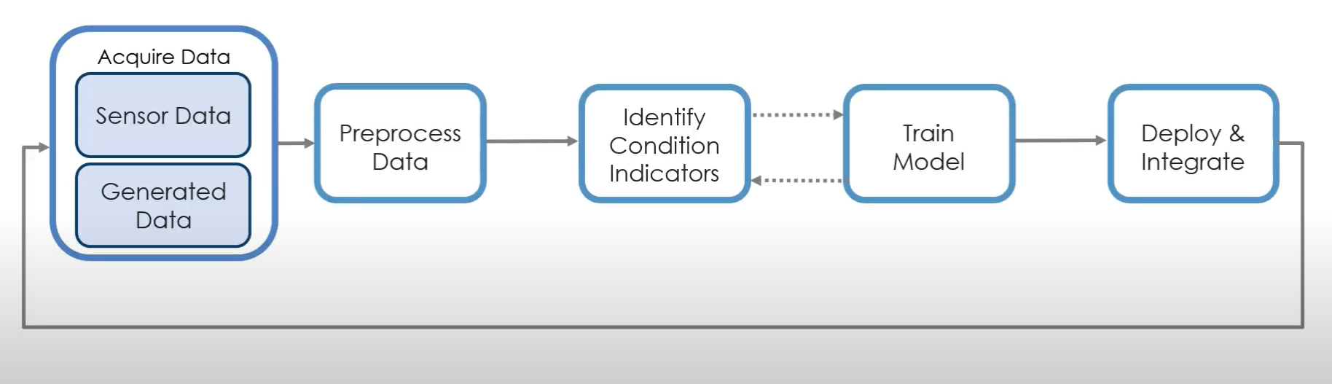
1. Introduction
“Overview Artificial Intelligence”
High-order neural network artificial intelligence refers to AI systems that can dynamically transform multiple data types (text, image, audio, video) into unified models that can understand and generate complex, contextually rich outputs.
Performance Workflow
3

Slide 4
1. Introduction
Background
The primary motivations of AI development systems include efficiency, solving complex problems, and improving decision-making.
Proposed method
The AI system will be utilized with deep learning techniques including high-order neural networks(HOONs).
In the mid-19th century, George Boole developed Boolean algebra, which became fundamental in the creation of digital circuits.
Motivation
In this study, we propose a high-order neural network (HOON) methodology for performing the performance of an AI system.
4

Slide 5
2. The high-order neural network
“Parameters”
Input Layer | Units representing the initial input features to the network.
Weight Parameters | Coefficients that multiply the input variables and their interactions.
Bias Terms | Constants added to the weighted sum of inputs to adjust the output.
Activation Function | Non-linear functions applied to the weighted sums of inputs to introduce non-linearity.
Output Layers | Units representing the final output predictions of the network.
https://www.google.com/url?sa=i&url=https%3A%2F%2Fmedium.com%2F%40bryanc.limble%2Fan-introduction-to-predictive-maintenance-pdm-with-cmms-c1dcec1e0284&psig=AOvVaw1AUBArkICR_mXE_KMo3HuA&ust=1717898064829000&source=images&cd=vfe&opi=89978449&ved=0CBIQjRxqFwoTCMjt55XzyoYDFQAAAAAdAAAAABAE
Learning Rate | Hyperparameter controlling the step size during the optimization process.
Regularization Parameters | Techniques to prevent overfitting by adding constraints or penalties to the model.
Loss Function | Measure of the discrepancy between the predicted values and the actual values

Slide 6
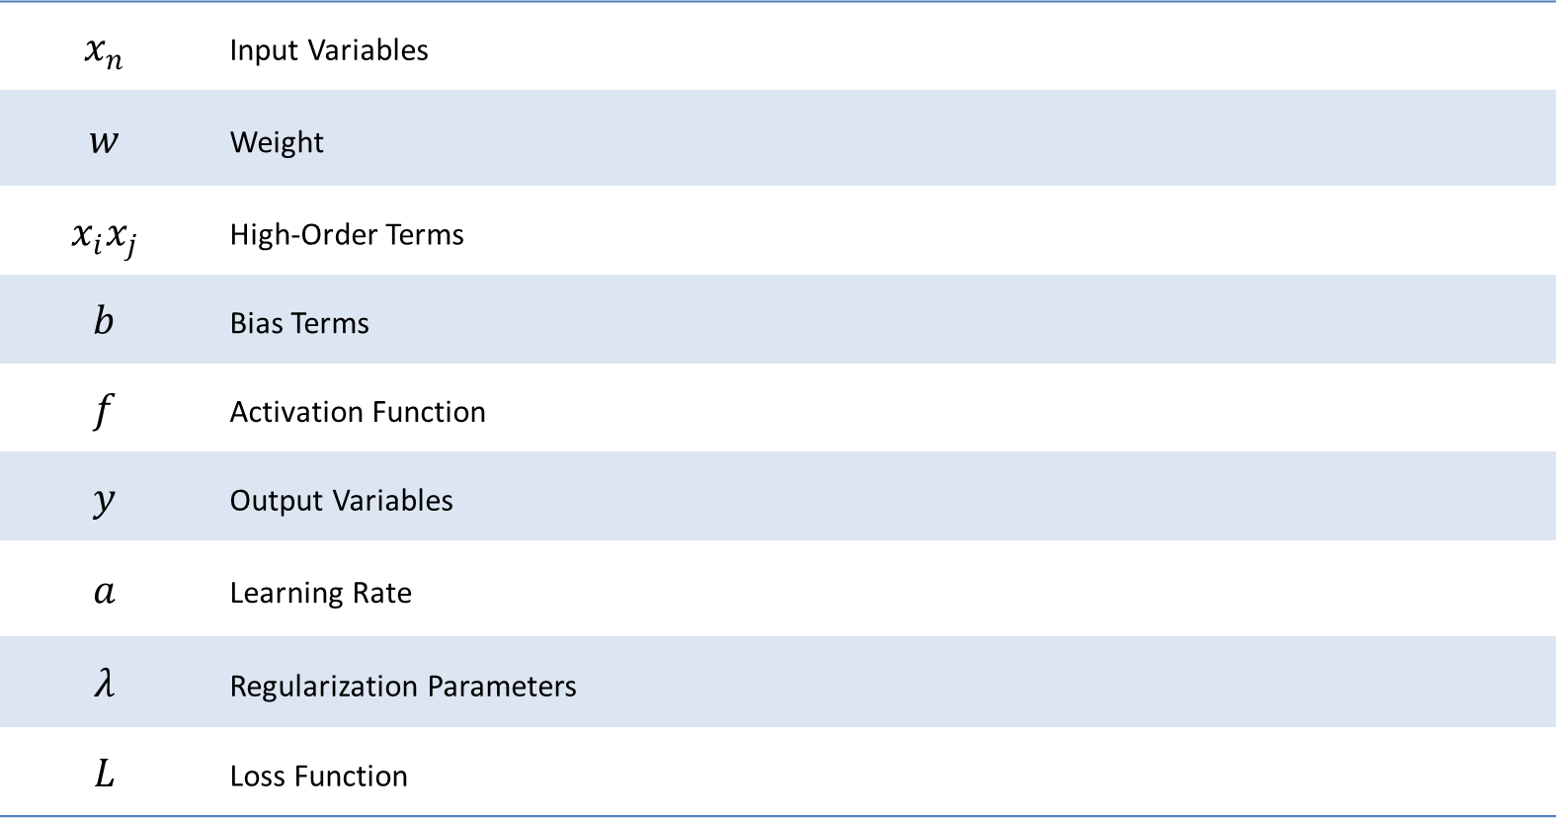
2. The high-order neural network
“Variables”
$$x_{n}$$ | Input Variables
$$w$$ | Weight
$$x_{i}x_{j}$$ | High-Order Terms
$$b$$ | Bias Terms
$$f$$ | Activation Function
$$y$$ | Output Variables
$$a$$ | Learning Rate
$$λ$$ | Regularization Parameters
$$L$$ | Loss Function

Slide 7
3. Methodology
“ HOON function ”
High-order neural networks (HOONs) provide a powerful extension to traditional neural networks by incorporating higher-order combinations of input features. This allows them to capture more complex relationships within the data, potentially leading to better performance on tasks with intricate dependencies. However, this increased power comes with additional computational costs and the risk of overfitting, necessitating careful design and regularization.

Slide 8
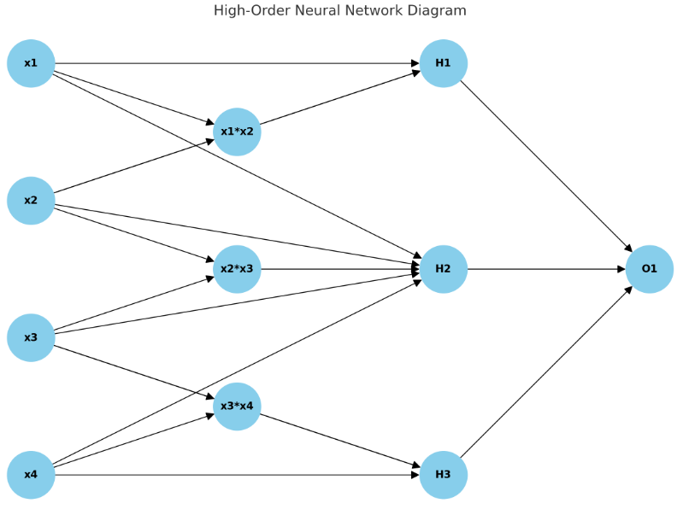

3. Methodology
“Model Formulation” – The HOON model:
Weighted Sum with Bias${(z}_{i}):$
$z_{i}^{\left(1\right)}=$ $Σ_{i=1}^{n}w_{ij}^{(1)}w_{j}$ + $a_{j}^{\left(1\right)}$
High-Order Terms:
$z_{i}^{\left(2\right)}=$ $Σ_{i=1}^{n}Σ_{k=j}^{n}$ $w_{ijk}^{(2)}x_{j}x_{k}$
$z_{i}^{\left(3\right)}=$ $Σ_{i=1}^{n}Σ_{k=j}^{n}Σ_{l=k}^{n}w_{ijkl}^{(3)}x_{j}x_{k}x_{l}$
Hidden Layer $\left(l\right)$
$z_{i}^{\left(l\right)}$ $=Σ_{j}w_{ij}^{\left(l\right)}a_{j}^{\left(l−1\right)}$+ $b_{i}^{\left(l\right)}$+ $Σ_{j,k}w_{ijk}^{\left(l\right)}a_{j}^{\left(l−1\right)}a_{k}^{\left(l−1\right)}$
Activation Function ($a_{i}$):
$a_{i}$ = $f{(z}_{i})$
Output Layer $\left(y\right)$
$y=Σ_{i}w_{\dot{i}}^{\left(out\right)}a_{i}^{\left(L\right)}+b^{\left(out\right)}$
Regularization Terms $\left(λ\right)$
$$L_{total}=L+λ_{1}Σ_{i}\left|w_{i}\right|+λ_{2}Σ_{i}w_{i}^{2}$$

Slide 9
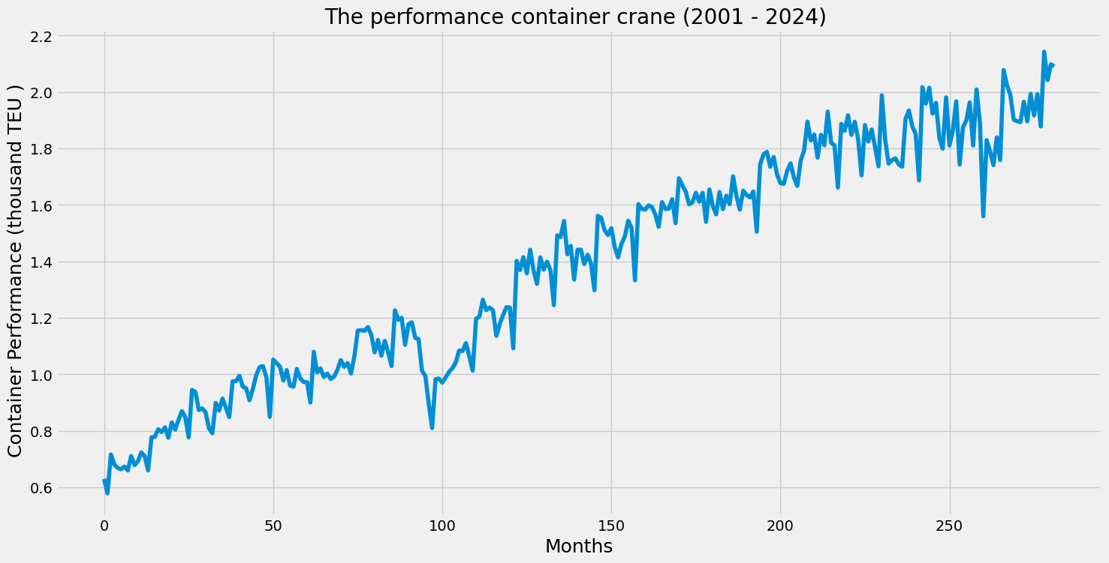
4. Simulation
“Explanation data frame”
This database includes 500 data points. The data is being collected from a computer to calculate the number of containers being processed per year. It will be split into 80 and 20 which is 20% of the training data will be used for validation, and the remaining 80% will be used for training.

Slide 10
4. Stimulation
“Explanation data frame”
Batch size is a term used in machine learning that refers to the number of training examples utilized in one iteration of model training. The model uses 32 batch size because it provides efficient and stable training, especially with large datasets and powerful hardware.
An epoch is a term used to describe one complete pass through the entire training dataset. An epoch represents a complete cycle of forward propagation and backward propagation over the entire dataset. The model uses 100 epochs because it allows the model sufficient iterations over the entire dataset to learn complex patterns.

Slide 11
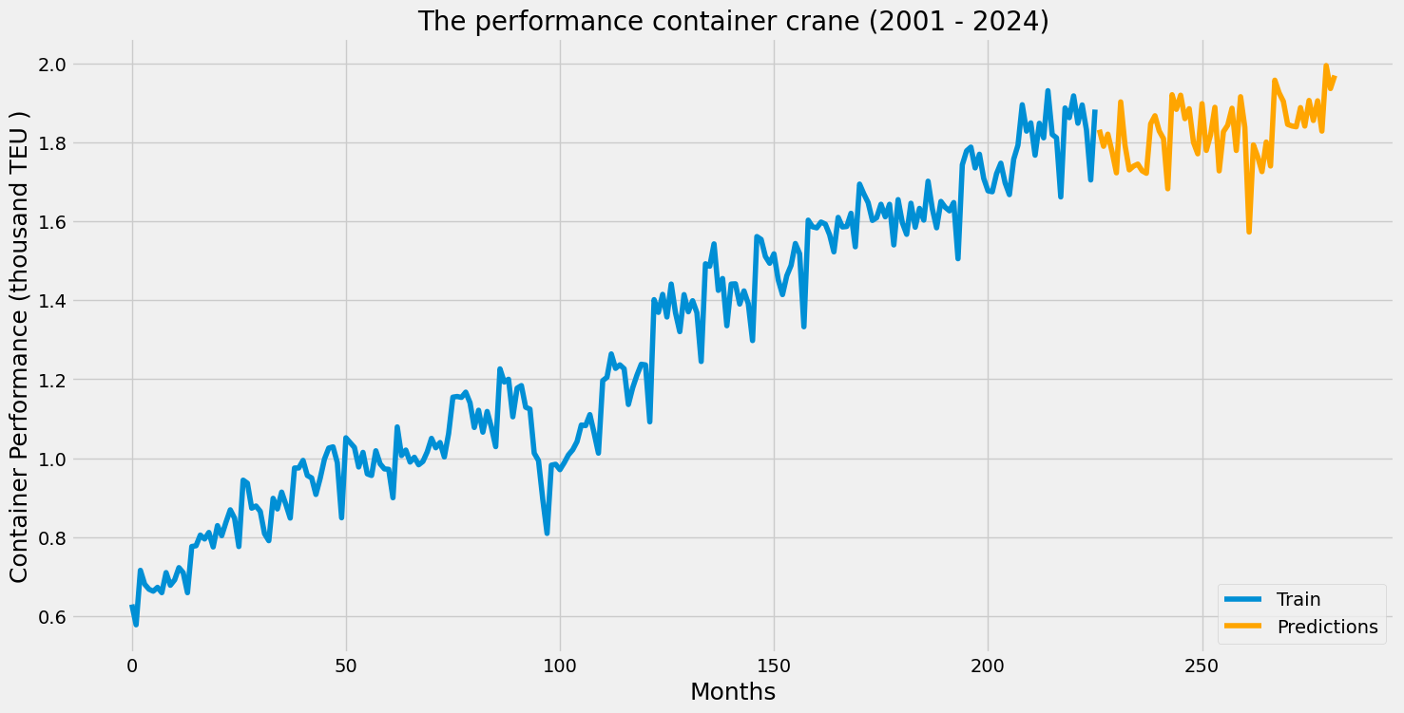
5. Result
Figure 1. Predicting the failure of a container crane by RNN model
Training Data (Blue Line): Shows actual rotor speed, starting with fluctuations, stabilizing in the middle, and ending with more variability.
Predictions Data (Orange Line): Continues from the training data, showing similar variability, with an increase, a peak, and then a decline, followed by minor fluctuations.

Slide 12
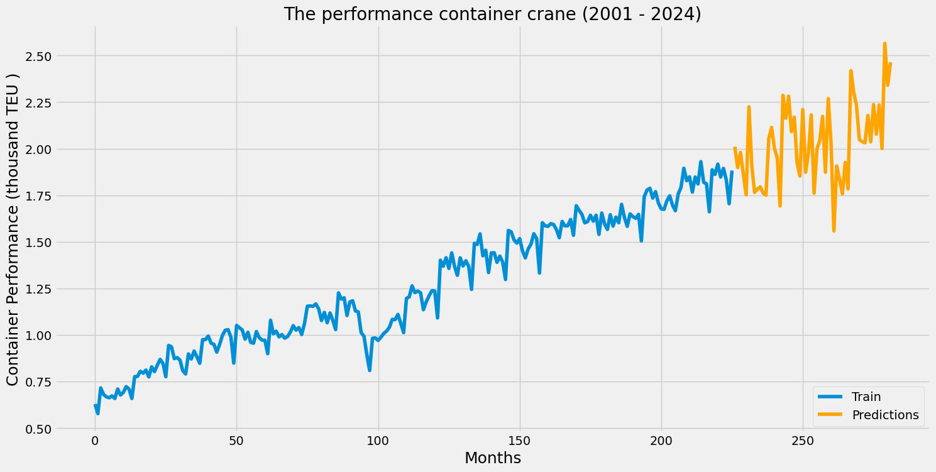
5. Result
Figure 2. Predicting the failure of a container crane by HOON model
Train Data (Blue Line): Displays the true rotor speed, which varies at first before settling and then becoming more variable.
Predictions (Orange Line): Carries over from the training data, displaying comparable variability in the form of tiny fluctuations interspersed with a peak, a decrease, and a rise.

Slide 13
5. Result
Figure 6. Comparison
Comparison: the two charts are comparing different models, it seems that the model in the right chart may have higher variance or is more sensitive to changes compared to the model in the left chart while The left chart’s model appears more stable but might underreact to changes, showing a smoother but potentially less accurate trend.

Slide 14
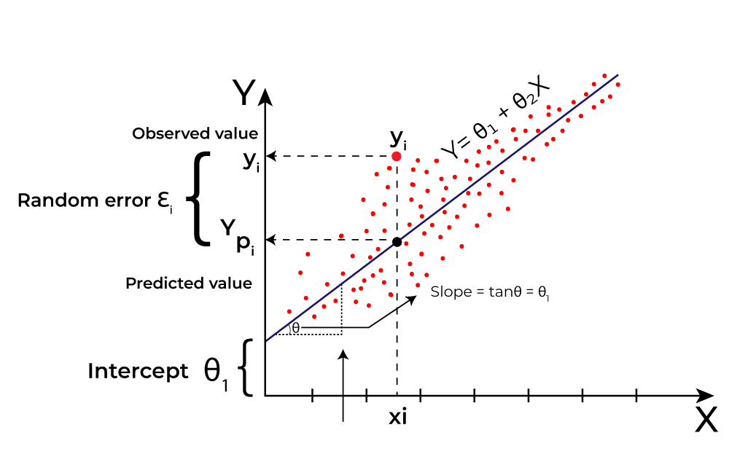

5. Result
“Explanation formular”
In this prediction, MAE, MSE, and RMSE are the parameters that show the rate of prediction can fail.
$$MAE = \frac{1}{n}\sum_{i=1}^{n}{\left|y_{i}−ŷ_{i} \right|}$$
$$MSE = \frac{1}{n}\sum_{i=1}^{n}{({y_{i}−ŷ_{i})}^{2}}$$
$$RMSE = \sqrt{\frac{1}{n}\sum_{i=1}^{n}{({y_{i}−ŷ_{i})}^{2}} }$$

Slide 15
5. Result
“Explanation chart visualization”
As shown in Figure 4 Mean Squared Error (MSE), Mean Absolute Error (MAE), and Root Mean Squared Error (RMSE) are popular metrics used to measure the accuracy of prediction models in statistics and machine learning. These metrics evaluate how close the predictions of a model are to the actual outcomes. It can be understood that the lower the number the more accurate the prediction.
Figure 4. Performance Model Metrics
Models | Metrics
 | MAE | RMSE | MSE
HOONs | 0.0205 | 0.1321 | 0.0174
LSTM | 0.0967 | 0.2450 | 0.0600

Slide 16
6. Conclusion
“Summary of the Study”
This article examines forecasting machine performance using Recurrent Neural Networks (RNNs) and High-Order Neural Networks (HONNs). These models are versatile, flexible, and adept at managing long-range dependencies, making them suitable for various data types and applications.
“Discussion”
The comparison of neural network models is a critical step in the development and deployment of AI systems, enabling researchers and practitioners to select the most effective model for a given task.
“Contribution”
HONNs can model complex interactions between multiple input features, capturing relationships beyond first-order and second-order models, allowing them to understand intricate data patterns
“Future Work”
Expanding the ability of artificial intelligence to develop the potential of AI continuously.

Slide 17
References
Goriveau, Rafael; Medjaher, Kamal; Zerhouni, Noureddine (2016-11-14). From prognostics and health systems management to predictive maintenance 1 : monitoring and prognostics. ISTE Ltd and John Wiley & Sons, Inc. ISBN 978-1-84821-937-3.
Mobley, R. Keith (2002). An introduction to predictive maintenance (2nd ed.). Butterworth-Heinemann. pp. 4–6. ISBN 978-0-7506-7531-4.
Wierstra, Daan; Foerster, Alexander; Peters, Jan; Schmidhuber, Juergen (2005). "Solving Deep Memory POMDPs with Recurrent Policy Gradients". International Conference on Artificial Neural Networks.
Amruthnath, Nagdev; Gupta, Tarun (February 2018). "Fault Class Prediction in Unsupervised Learning using Model-Based Clustering Approach".
Mather, D. (2008). "The value of RCM". Plant Services
Kennedy, Sheila (2006). "New tools for PdM". plantservices.com. Putman Media. Retrieved 19 Nov 2019.
McCulloch, W; Pitts, W (1943). "A Logical Calculus of Ideas Immanent in Nervous Activity". Bulletin of Mathematical Biophysics. 5 (4): 115–133. doi:10.1007/BF02478259.
Hebb, D.O. (1949). The Organization of Behavior. New York: Wiley & Sons.
Bain (1873). Mind and Body: The Theories of Their Relation. New York: D. Appleton and Company.
Levitan, Irwin; Kaczmarek, Leonard (August 19, 2015). "Intercellular communication". The Neuron: Cell and Molecular Biology (4th ed.). New York, NY: Oxford University Press. pp. 153–328. ISBN 978-0199773893.

Slide 18
Thank you for your attention!

